Slide 1

FLIGHT DELAY PREDICTION

Slide 2
TABLE OF CONTENTS
BUSINESS PROBLEM
SOLUTION APPROACH
EXPLORATORY DATA ANALYSIS
PHASE 1
PHASE 2
PHASE 3
ACTIONABLE RECOMMENDATIONS

Slide 3
BUSINESS PROBLEM
To understand the reasons for the delay or cancellation of flights, it can be due to inefficient services from the origin airport or heavy traffic or the services provided by the airlines. The goal is to classify the dataset used into two groups and predict the delay and cancellation of flights through different machine learning models.

Slide 4
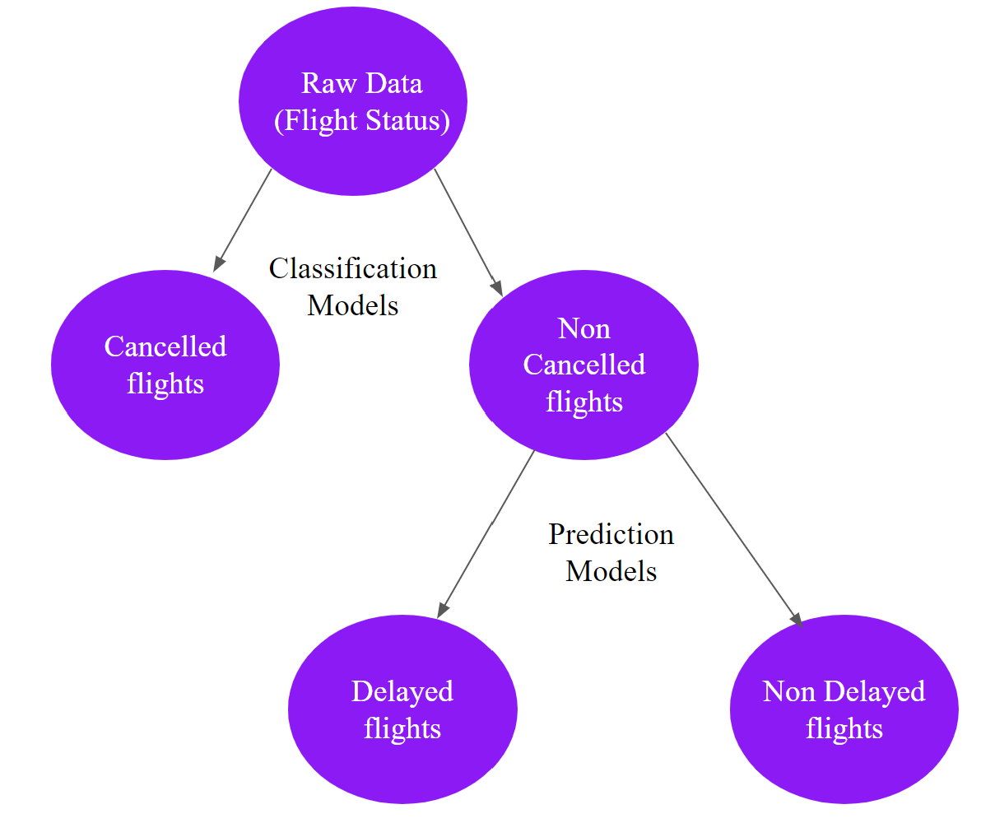
SOLUTION APPROACH
Exploratory Data Analysis
Removal of Nuisance Variables
Dealing with Missing Values
Problem of Classification
Problem of Prediction

Slide 5
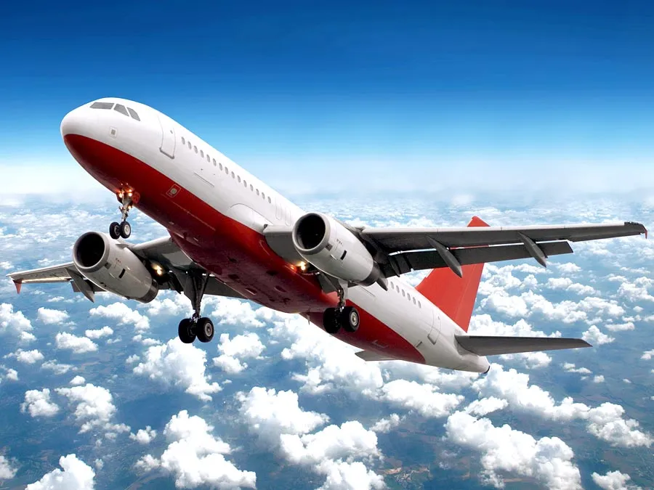
EXPLORATORY DATA ANALYSIS
PART 1: Cancelled Flights

Slide 6
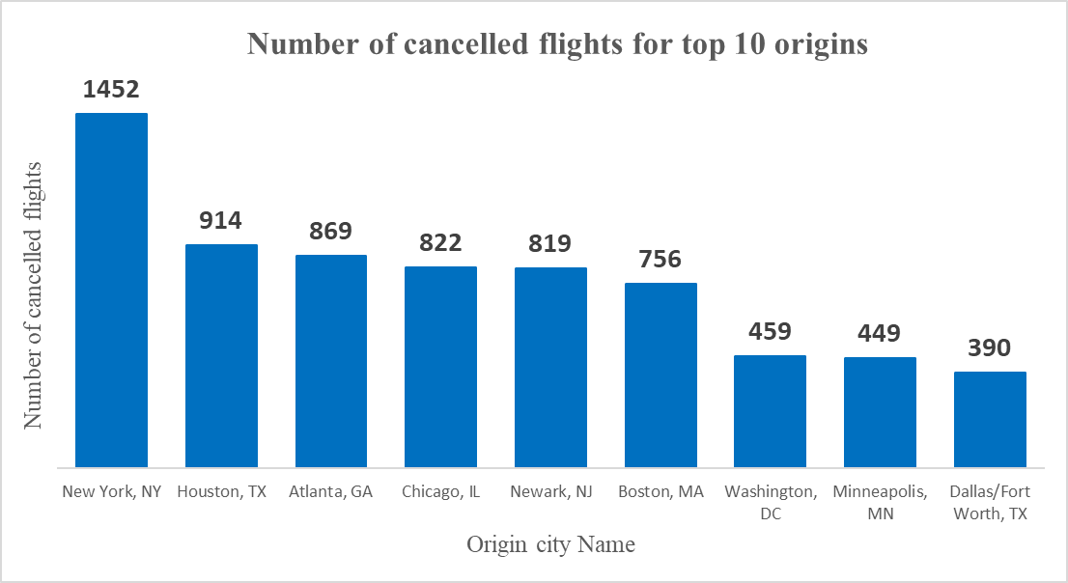
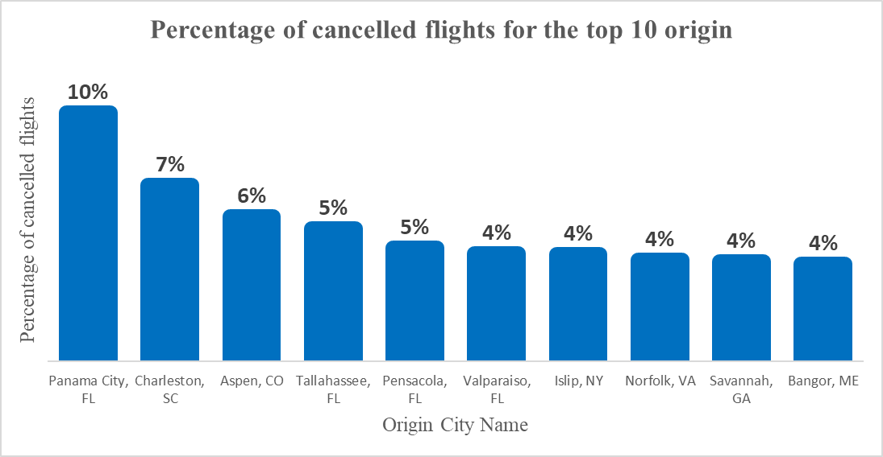
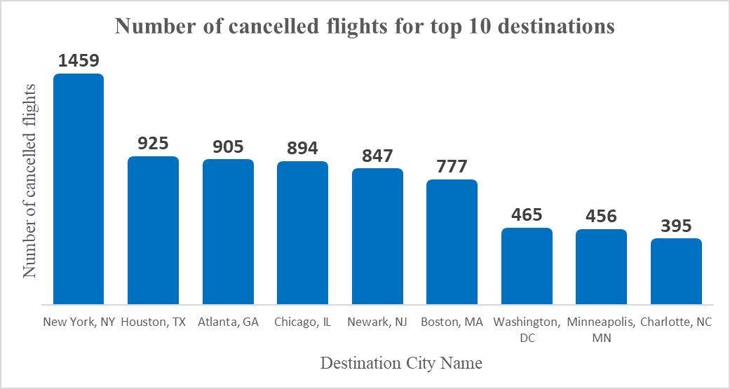
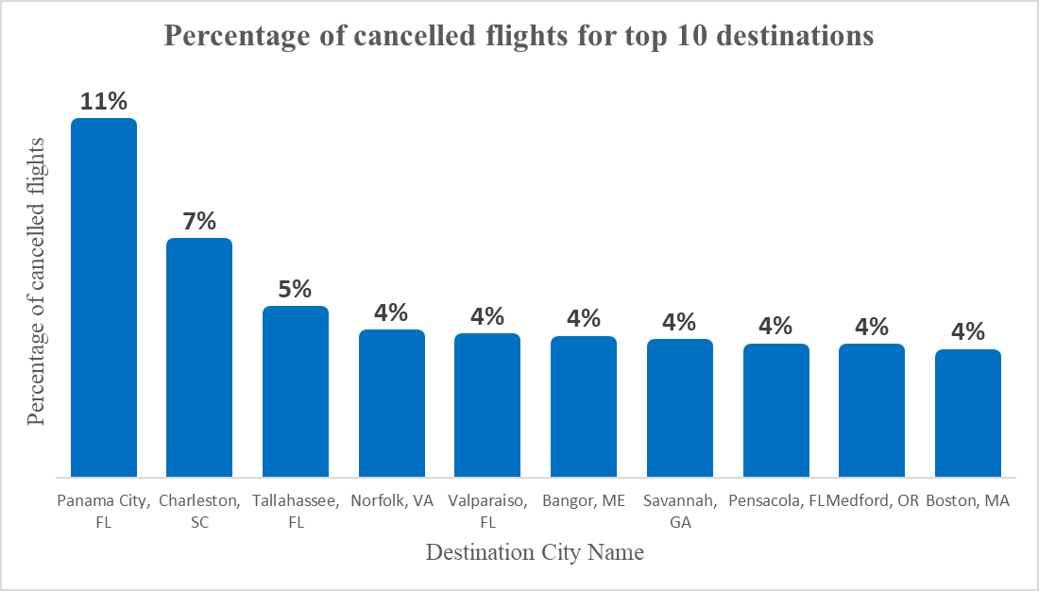
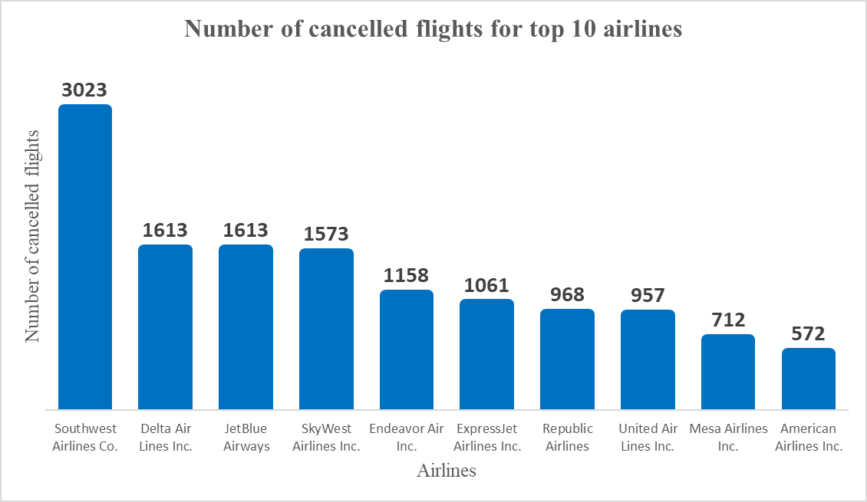
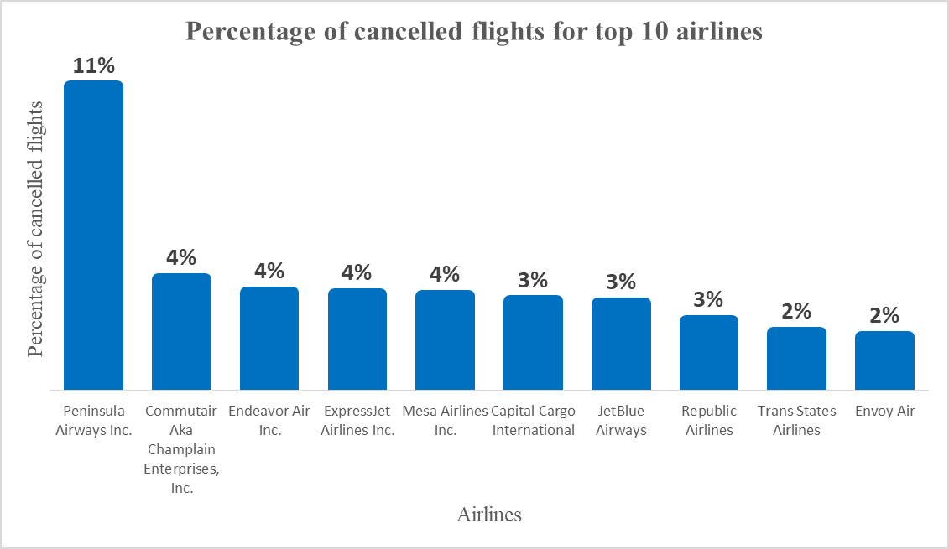

Slide 7
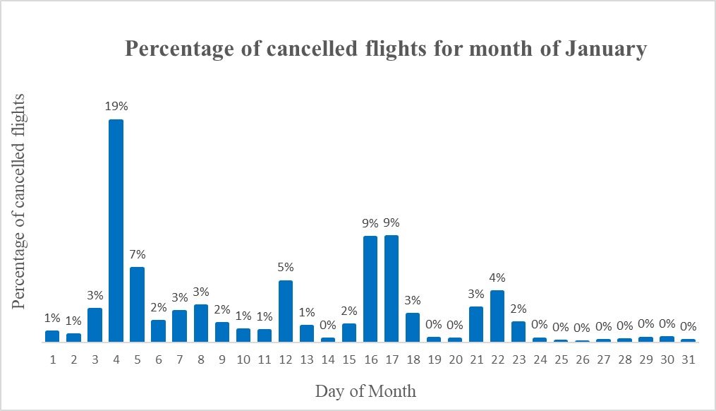
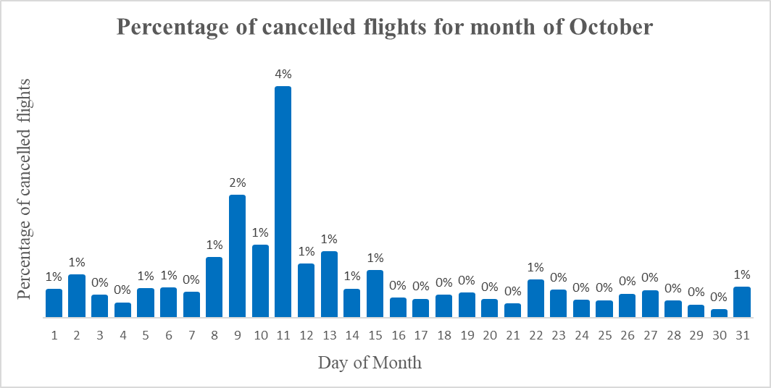
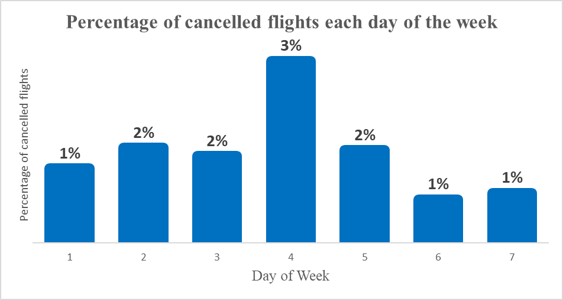

Slide 8
PHASE 1: CLASSIFICATION OF FLIGHTS INTO CANCELLED / NON CANCELLED.
Objective - To predict whether a flight will get cancelled or not.
Variables Selected
Target variable | ‘Cancelled’ : Cancelled Flight Indicator (1=Yes)
Feature variables | ‘Distance’: Distance between airports (miles) ‘DayofMonth’ : Day of Month ‘DayOfWeek’: Day of Week ‘Flight_Number_Operating_Airline’: Flight Number ‘OriginAirportID’: An identification number assigned by US DOT to identify a unique airport. ‘DestAirportID’: Destination Airport, Airport ID.

Slide 9
Models Used - Decision Tree Classifier, Random Forest Classifier, Naive-Bayes Classifier
Model Accuracy
Classification Models | Accuracy
Decision Tree Classifier | 98.38%
Random Forest Classifier | 61.96%
Naive Bayes Classifier | 81%

Slide 10
PHASE 2: CLASSIFICATION OF FLIGHTS INTO DELAYED /NON DELAYED.
Objective - To classify the flights as delayed/non delayed and to predict whether the flight will be delayed at the arrival or not.
Variables Selected
Target variable | ‘Flight_Status’ : A binary variable representing the difference between scheduled arrival and actual arrival. (1 = Delayed, 0 = On time/non-delayed)
Feature variables | ‘Diverted’:Diverted Flight Indicator (1=Yes) ‘DepDelayMinutes’ : Difference in minutes between scheduled and actual departure time. Early departures show negative numbers. ‘Distance’: Distance between airports (miles) ‘DayofMonth’ : Day of Month ‘DayOfWeek’: Day of Week ‘Flight_Number_Operating_Airline’: Flight Number ‘OriginAirportID’: Origin Airport, Airport ID. ‘DestAirportID’: Destination Airport, Airport ID.

Slide 11
Models Used - Decision Tree Classifier, Naive Bayes Classifier
Model Accuracy
Classification Models | Accuracy
Decision Tree Classifier | 84.24%
Naive Bayes Classifier | 82.4%

Slide 12
EXPLORATORY DATA ANALYSIS
PART 2: Delayed Flights

Slide 13
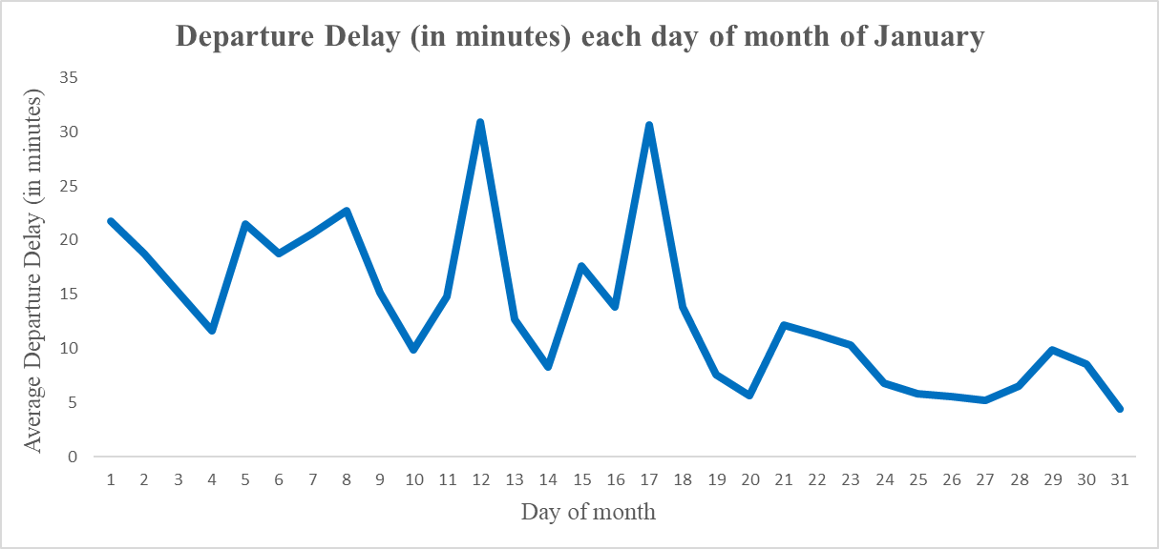
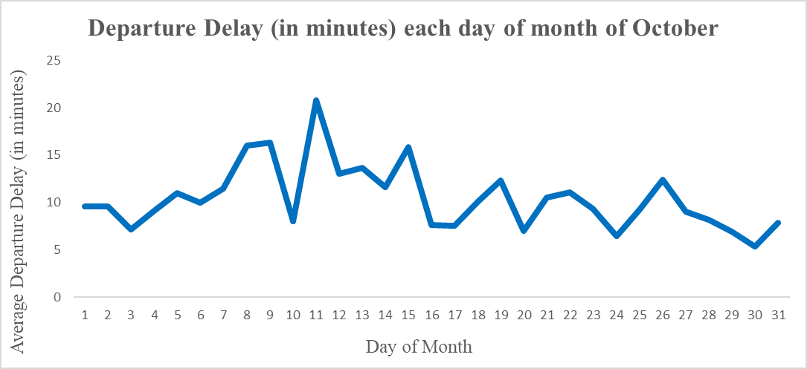
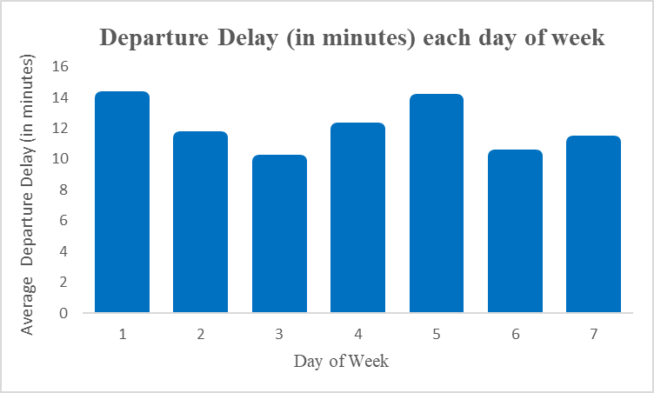
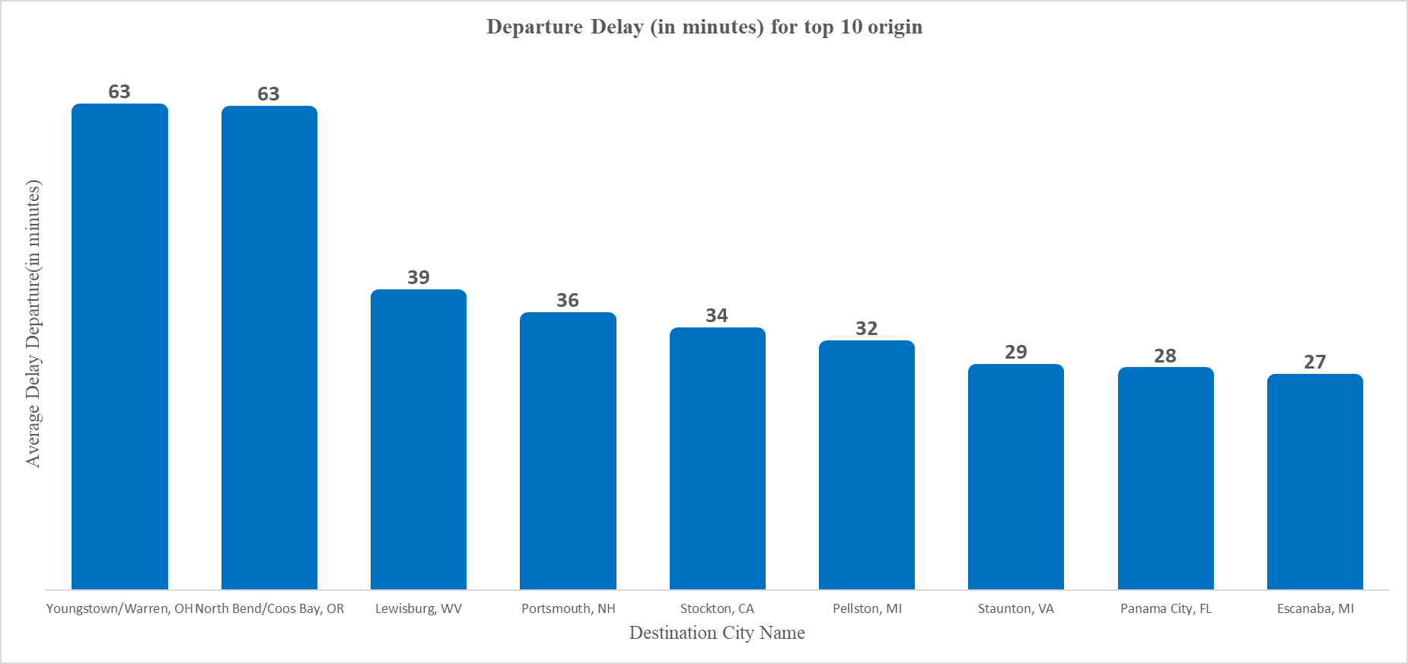
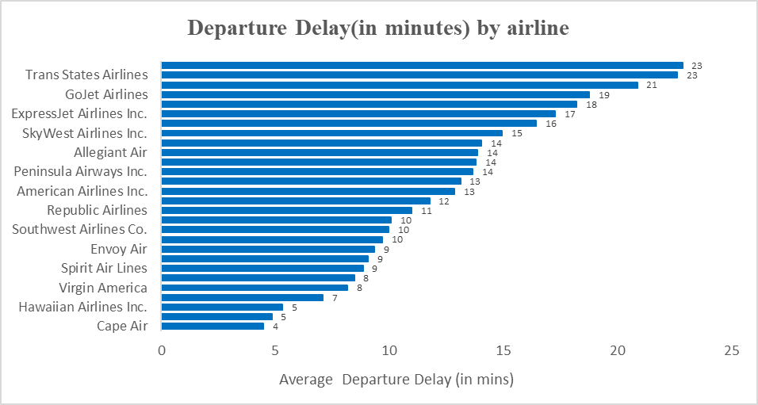

Slide 14
PHASE 3: PREDICTION OF DELAY TIME.
Objective - To predict the delay in departure of a flight.
Why predict departure delay ?
Variables Selected
Target variable | ‘DepDelayMinutes’ : Difference in minutes between scheduled and actual departure time. Early departures show negative numbers.
Feature variables | ‘Distance’: Distance between airports (miles) ‘DayofMonth’ : Day of Month ‘DayOfWeek’: Day of Week ‘Flight_Number_Operating_Airline’: Flight Number ‘OriginAirportID’: An identification number assigned by US DOT to identify a unique airport. ‘DestAirportID’: Destination Airport, Airport ID. ‘TaxiOut’: Taxi out time, in minutes

Slide 15
Models Used - Extreme Gradient Boost Regression, Random Forest Regression
Model Accuracy
Predictive models | Root Mean Squared Error | Mean Absolute Percentage Error
Extreme Gradient Boost Regression | 36.9 | 37.85%
Random Forest Regression | 28.76 | 32.83%

Slide 16
ACTIONABLE RECOMMENDATIONS
Timely prediction of weather conditions.
Better understanding of airports which are heavily crowded and if so at what timings in order to determine efficient routes with minimum delay possibility.
Gather more information on variables such as Carrier Delay, Security Delay, Late Aircraft Delay for improved prediction of departure delay time.
There are certain airports where cancellation of flights are more, but not much delayed flights and vice versa. It does not necessarily mean that the particular airport or airline is not good, they should improve their services in which they lack and should improve in that particular aspect.

Slide 17
THANK YOU

